Slide 1
FY 2023-24 Budget Kickoff
with Mayor and Council
Council Conference Room
Thursday, October 27, 2022 | 4:00 p.m.

Slide 2
Agenda
Current Year Budget Actions
Process Review and Theme
Budgetary Impacts for New Year
Strategic Framework (Goals/Focus Areas)
Action Items to Achieve Strategic Framework
Capital Guidelines
Financial Policies
Key Dates
- Council Direction

Slide 3
FY 2022-23 Budget Actions
Sales tax rates unchanged - one of the lowest in AZ
Reduced property tax rate from $1.1126 to $1.1026 per $100 of assessed value - 7Th year of reduction
Water/Wastewater/Reclaimed & Solid Waste Rate Changes went into effect July 1, 2022
Added Inflationary Increases to operating budgets to compensate for affected budget lines
Increased CIP funding to account for anticipated inflation, maintain aging infrastructure, as well as finishing planned parks and arterial streets
Continued to address pension debt through additional one-time funding towards pay-down of PSPRS unfunded liability (+50M / $125.3M to date)
Adds funding for labor association commitments, general employee pay increases, and Classification and Compensation study estimated impacts
Added positions in critical areas such as Public Safety, Courts, IT, Facilities, Parks, Planning, and Public Works

Slide 4
Where We Are in the Budget Process
Kickoff allows for Council direction on Strategic Goals/Focus Areas action items, policies & guidelines before budget process begins & Resident Budget Survey initiated
Decision Package and CIP recommendations submitted by departments in December
Financial forecast, funding decisions brought to Council during workshops 1 (February) and 2 (March)
Proposed budget brought to Council for discussion at all-day briefing (April)
Notes:
Add survey

Slide 5
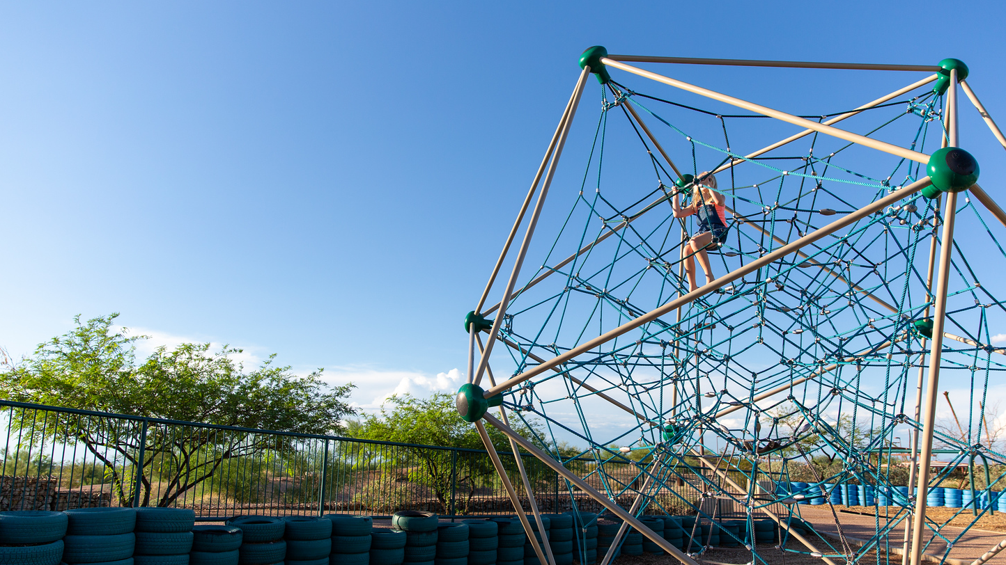
FY 2023-24 Budget Theme
Innovation at Work
Our Brand
A safe, diverse, equitable and inclusive
community that connects people, chooses
innovation and inspires excellence

Slide 6
FY 2023-24 Budgetary Impacts
The Brightside
Personnel/Staffing
Public Safety Personnel Retirement System (PSPRS) unfunded liability is decreasing, which allows for freed up ongoing funding
This year’s budget allowed for more substantial market adjustments and some impacts of Class and Comp study were incorporated
Local Economic Impacts
Local revenues continue to come in strong
Intel construction impacts are being seen in our monthly revenues
New retail will bring a destination-based shopping experience to Chandler, increasing revenues
State shared income tax shifting from 15% to 18% to offset flat tax implications, but increase this year is one-time
Inflation is driving revenues higher
Long tradition of strong financial management

Slide 7
FY 2023-24 Budgetary Impacts Delineating Ongoing vs. One-Time
The Challenges
Personnel/Staffing
Retirement and vacancy impacts are still an issue
Attracting talent to fill vacancies
Class and Comp study impacts not yet fully known
ERP system will require significant city-wide staff effort
Inflation & Supply Chain
Affecting utilities, chemicals, construction materials and labor, vehicles, and equipment
Potential Legislative Impacts
Legislative Impacts to local tax base and Model City Tax Code
Threat of eliminating residential rental and food for home consumption tax ($22M-$25M ongoing)
State shared income tax final level after flat tax implemented unknown
Prop 400 extension future is uncertain (longer term)
Technology
Multi-year City-wide Enterprise Resource Planning (ERP) system replacement
Security posture / Infrastructure
Governance / speed to delivery
Mobility and flexibility / more to do

Slide 8
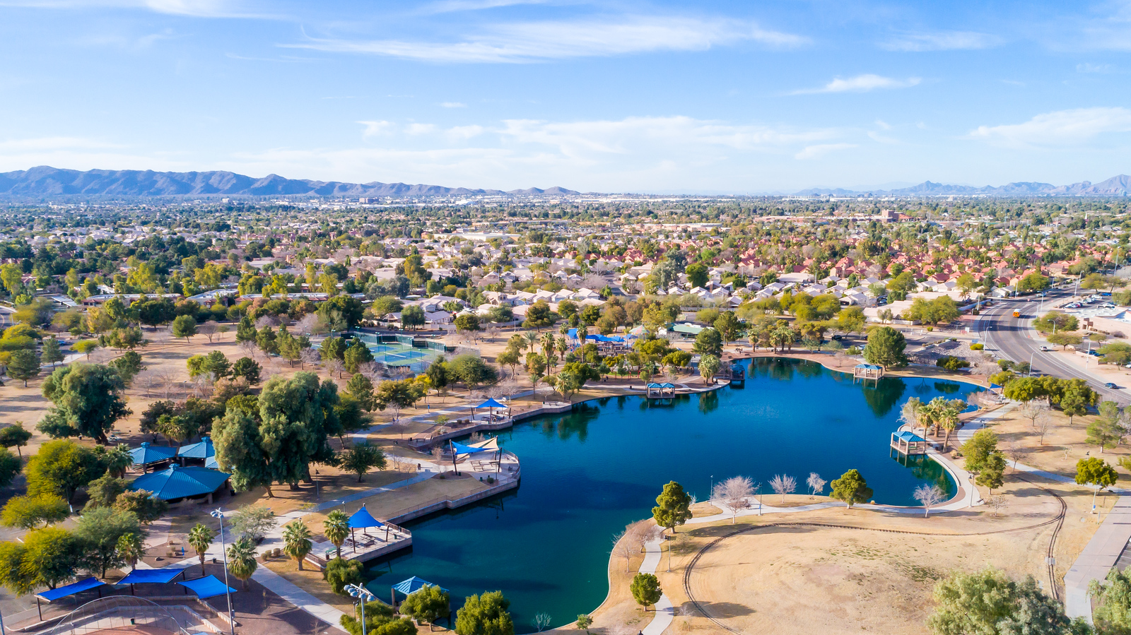
Strategic Framework Guides Our Decision Making
Strategic Policy Goals
Focus Areas
Being the Most Connected City
Being a Leader in Trust and Transparency
Maintaining Fiscal Sustainability
Attracting a Range of Private Sector Businesses
Fostering a Contemporary Culture that Embraces Unity
Being Safe and Beautiful
Economic Vitality
Innovation and Technology
Mobility
Neighborhoods
Quality of Life
Good Governance
Notes:
The Council’s Strategic Policy Goals continue to build on the vision of its leaders. They maintain fiscal sustainability and provide great value to our citizens with conservative planning and forward thinking.
Our Council Strategic Goals of …… and Focus Areas of ……….. Continue to be a Fiscal Foundation in our budget process. Each Service we provide or Capital Project that is initiated or planned is linked to a goal and focus area which allows us to stay focused on the Vision set by our City Leaders.

Slide 9
Action Items to Achieve the Strategic Framework Goals
Economic Vitality, 2 Year Action Plan
Economic Vitality
Preserve employment corridors, develop the Airpark, repurpose vacant retail, attract visitors to Chandler, be strategic about infill and redevelopment, and partner with higher education.
Completed
Airpark area plan
Downtown alley way study
RFP & award for executive hangars
Expand UofA to the Jonathan Building (Ribbon cutting 11/2)
City Internship program coordinator for CGCC hired
Three-year tournament contracts at Snedigar
In Process
Airpark Area signage
Downtown Area Plans
Pedestrian & Wayfinding Study
Urban Land Institute Study
Airport Strategic Business Plan
City Ordinance update for promoting redevelopment
Improve Utilization of ASU Innovation
Healthy Urban Environment Grant pedestrian corridor study in partnership with ASU (Wall St)
Regional air services for Super Bowl
Yet to Start
South Arizona Avenue Corridor update
Winn School/Salvation Army Campus Plan
Submit proposed State legislation to aide in redevelopment of commercial properties
Regulatory City code review to adapt to easier ways of doing business
Note: Redevelopment projects currently planned or under construction shown on Story Map
Notes:
Urban Land Institute Study for southside
the HUE Wall St. study was based on the "Week of Wall St." from March and is with ASU and Pinnacle Prevention

Slide 10
Action Items to Achieve the Strategic Framework Goals
Innovation & Technology, 2 Year Action Plan
Innovation & Technology
Smart and sustainable solutions, ideas that promote efficiency and connectivity, leverage partnerships and outside funding, make Chandler a global technology destination, and invest in technology infrastructure.
Completed
5 Electric vehicle charging stations at City Hall, Development Serv., and Fleet (solar)
5 additional electric vehicles added to Fleet
Adding stipulations by P&Z and City Council to have wiring for charging stations in new devl.
Energy efficiency requirements included in readoption of building code
Code updated to allow case by case approval of permeable pavers in lieu of asphalt
Two additional tools for security implemented
Neighborhood Resources data solution implemented (Building Blocks)
Fleet management system implemented
Brand standards updated
In Process
MAG RFP for electric vehicle charging feasibility study
Energy Audit Solicitation & Energy Cap upgrades
LED streetlight conversion contract approval
RFP for solar expansion plan
Review data center zoning requirements
City facility review for conversion to LED/touchless lighting
Automation of several paper/manual signature type processes including Utility billing changes
HR Digital Recruitment and marketing
Citywide Fiber upgrades
Yet to Start
Hardware distribution for in field plan review of as-built maps
Automate compensation management system

Slide 11
Action Items to Achieve the Strategic Framework Goals
Mobility, 2 Year Action Plan
Mobility
Integrated options to access employment corridors, convenient connections to East Valley, high-tech transit options, safe and attractive roadways and traffic systems, connect neighborhoods and places with multimodal pathways, and leverage regional resources.
Completed
Chandler Flex (Active Service)
Arizona Avenue Alternatives Analysis
McClintock Dr., Kyrene & Chandler Rd Bike Lanes
First mile last mile (Active service)
Road Projects (e.g. Alma School, Gilbert Rd.)
Western Canal crossing at UPRR
In Process
ADA improvements
LED streetlight conversion
Canal and Trail Improvements
Frye Rd. Protected Bike Lanes
Hunt Hwy. Traffic Calming & Bike Lanes Study
Autonomous Vehicles Industry Development
Fiberoptic Cable Upgrades
Prop 400 extension
SE Chandler Arterial Road projects (e.g. Cooper Rd. Chandler Heights)
Bike detection cameras
MAG emerging technology program
Price/Ocotillo Shared Use Path
SE Chandler Arterial Road Improvements
Yet to Start
Kyrene Road (Chandler Blvd. to Loop 202) Traffic Study
Road Projects (Cooper Rd. Extension)
Notes:
There was limited detail on this one, so I was not sure which categories these fell in.

Slide 12
Action Items to Achieve the Strategic Framework Goals
Neighborhoods, 2 Year Action Plan
Neighborhoods
Services aligned with needs in specific areas of the city, holistic approach to neighborhood improvement through internal and external partnerships, quality housing for diverse needs, and well-maintained/enhanced infrastructure.
Completed
Galveston Stakeholder meetings
Partnered with Galveston Elementary for bike safety and bike giveaway
Identified 29 encampments and remediated 2
Purchase of Apartments on Trails End for new housing project
ADA improvements at Mountain View
Water Infrastructure at Westwood Manor and Chieftain Village
Pepperwood event over 1301 volunteers
Bilingual pay program
Galveston and Amberwood Envision Events
Held 3 Golden Neighbors Events
Emergency Rental Assistance (Active Program)
IGA with Kyrene Unified School District for Recreational Programing
Southside Village Conservation District
In Process
Continue to hold EVNAACP meetings
Donation program with Salvation Army for 120 beds and sheet sets
More than $12,000 in requests for Diversity Mini-grants
RAD project with 157 new housing units
Water Infrastructure at Kingston neighborhood
Recreational programing at schools IGA
Review Development Codes to facilitate housing diversity choices
Gazelle Meadows and Harris Park Improvements
SRO grants expanded
Yet to Start
NA
Notes:
*Get EVNAACP

Slide 13
Action Items to Achieve the Strategic Framework Goals
Quality of Life, 2 Year Action Plan
Quality of Life
Public safety personnel/technology/training that supports partnerships, high landscaping and architectural standards, parks and amenities serving the surrounding area, public spaces usable year-round, events capitalizing on Chandler’s culture, and partnerships for cultural and recreational programs.
Completed
Behavioral Health Unit
Mental Health Conference
Support, Mental Health, and Veterans Courts
Homestead North Park (ribbon cutting Nov. 12)
Lantana Ranch Park
Field of Honor
Set up Chandler Museum Foundation
Recreation virtual platform
GIS encampment initiative
In Process
Navigator Program
Fire station 2 construction
Tumbleweed Park softball/baseball complex pre-construction services
Public art projects
Pool Equipment room controller
Reclaimed Water Interconnect Facility (RWIF)
Intel / SRP partnership for 230 KV lines
Change-up panhandling signs
Yet to Start
NA

Slide 14
Good Governance Goals
Continue technology enhancements to support mobility and efficiency solutions including beginning phase of ERP
Maximize use of grants and partnerships to achieve strategic goals
High Priorities
Building a 21st century workforce
Continue PSPRS paydown plan
Maintain existing City buildings based on Building Assessment
Notes:
Building a 21st century workforce
Class and Compensation for Chandler to attract strong workforce
Adjust health care contribution to support increased costs
Increase Police staffing to adjust to new policing models
Remote work / Mobility
Be the place where everybody wants to work (collaborative spaces)
Internship Program / Partnership
Innovation

Slide 15
Capital Guidelines
Minimize increase in property taxes
Maintain, enhance or re-imagine existing infrastructure
Finish planned construction of streets, parks, fiber and utility systems
Prior to adding capital, ensure related ongoing O&M can be supported
Utilize master plans to guide long-term capital investment
Deliver on commitments made to residents through 2021 bond election
Balance inflation, workload, and timely completion of high visibility and grant funded projects
Notes:
Another Fiscal Foundation that Moves us forward are M&C Capital Improvement Program Guidelines. We have prepared our 10- year CIP plan under these guidelines for a few years now, and they have served us well. The plan would be to slightly modify these for FY 2022-23.

Slide 16
Financial Policies
Operating Management
Capital Management
Reserves (Jan. 26, 2017) (Mar. 22, 2018)
Debt Management
Long-Range Financial Planning
Grant Management
Investment
Accounting, Auditing, and Financial Reporting
Pension Funding (annual update; June 9, 2022)
(Revised and adopted by Council January 14, 2016)
Notes:
Next, The City of Chandler developed strong Financial Policies many years ago that have been, and continue to be, the high standards set for stewardship over Chandler’s financial resources. They are also a guide for sound fiscal planning and budgeting, while maintaining fiscal integrity. Each year the Financial Policies are reviewed and adopted as part of the annual budget. A thorough review and update took place in 2015 and 8 were adopted in Jan. of 2016. Since then there have been 2 updates to the reserve policy and the Pension Funding policy was added in 2019 and is updated each year.
The updates to the City Financial Policies continue to institutionalize strong financial management practices, clarify the strategic intent for financial management, define boundaries,
manage risks to financial condition, support good bond ratings to minimize borrowing costs, and comply with established public management best practices.

Slide 17
Council Approved Budgeting Practices Support Financial Sustainability
Maintain AAA bond ratings from Moody’s, Fitch and S&P
Continue adherence to all fiscal policies
Remain Structurally balanced
Ongoing revenues support ongoing expenditures
One-time revenues support one-time expenditures
Maintain strong reserves
15% General Fund contingency reserve
Budget Stabilization reserve at a minimum of $10M
Manage expenditure growth
Focus on maintaining and/or modernizing existing services
Control Primary Property Tax
Provide options should the forecast allow reduction
Notes:
Reserve: Build a budget that leaves this alone.....
The City’s Sound Budgeting Practices Support our Financial Sustainability. …
For FY 2022/23 5% of tax revenue would be $15.5M

Slide 18
Tentative Key Budget Dates
Budget Event |  |  | Date
Council Budget Kickoff |  |  | Tonight
Citizen Budget Survey with Council Outreach Videos |  |  | Nov-Dec 2022
Council Workshop 1 |  |  | February 9, 2023
Potential Additional Outreach |  |  | Early March
Council Workshop 2 |  |  | March 23, 2023
All-Day Budget Brief |  |  | April 28, 2023
Council Meetings: | Amendment Discussion | Amendment Discussion | May 11, 2023
 | Tentative Adoption | Tentative Adoption | May 25, 2023
 | Public Hearing & Final Adoption | Public Hearing & Final Adoption | June 15, 2023
 | Adoption of Tax Levy | Adoption of Tax Levy | June 29, 2023
Notes:
Can you make this a chart in PP please?

Slide 19
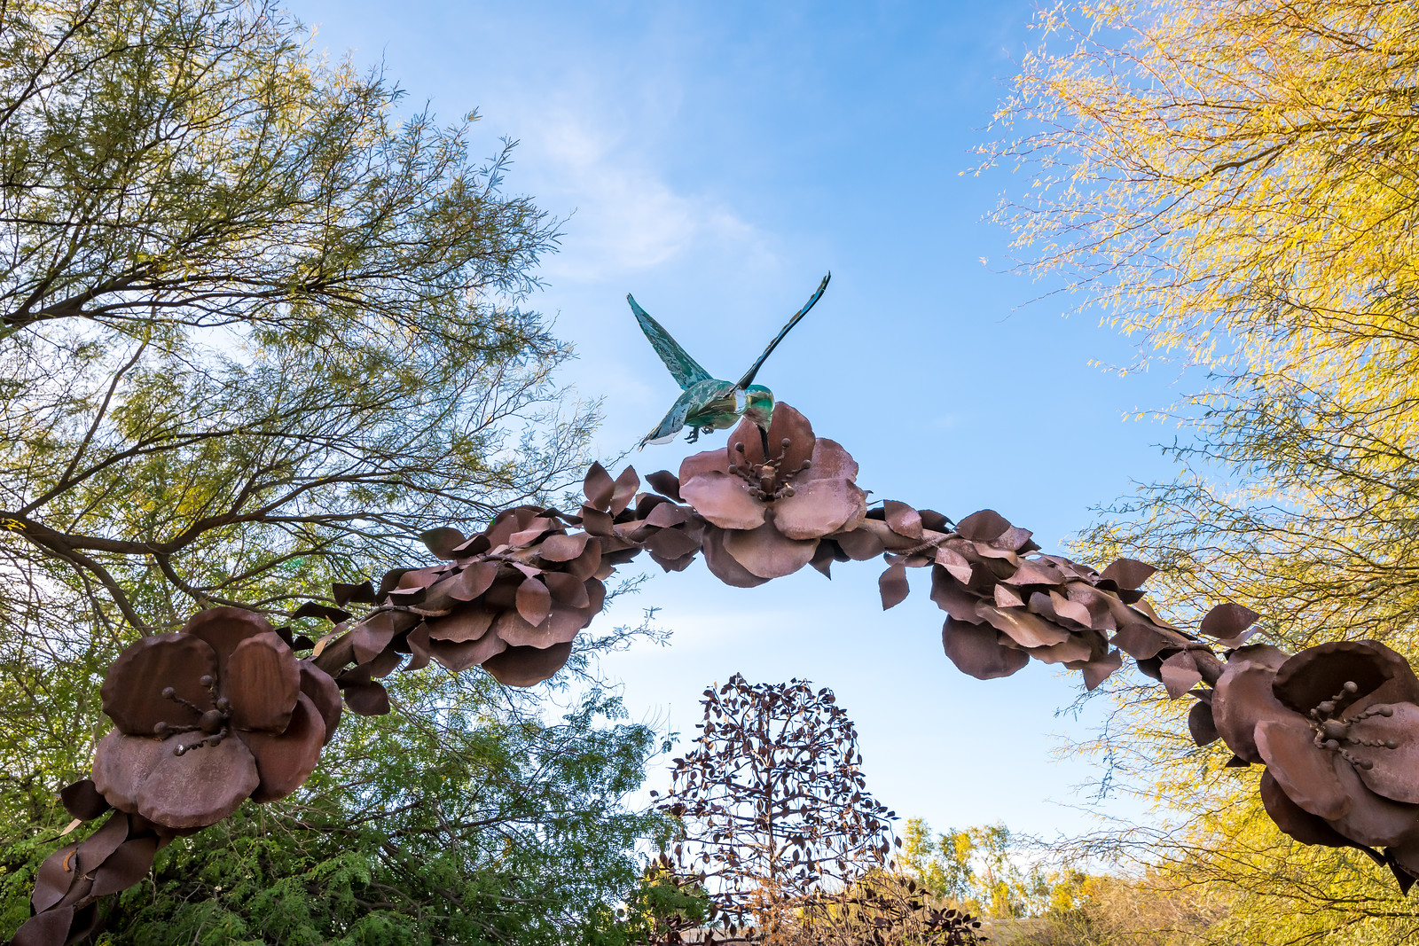
Questions?

